Slide 1
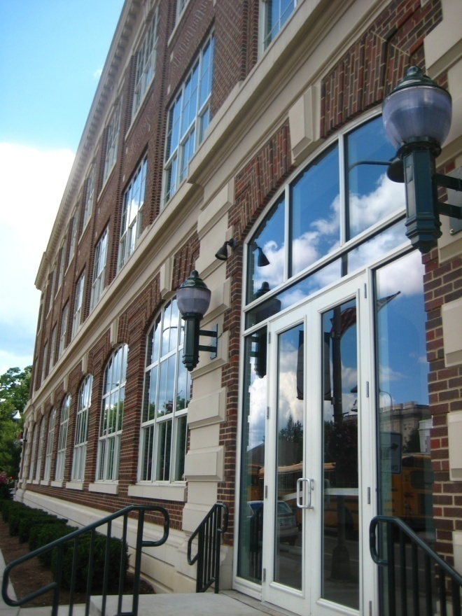
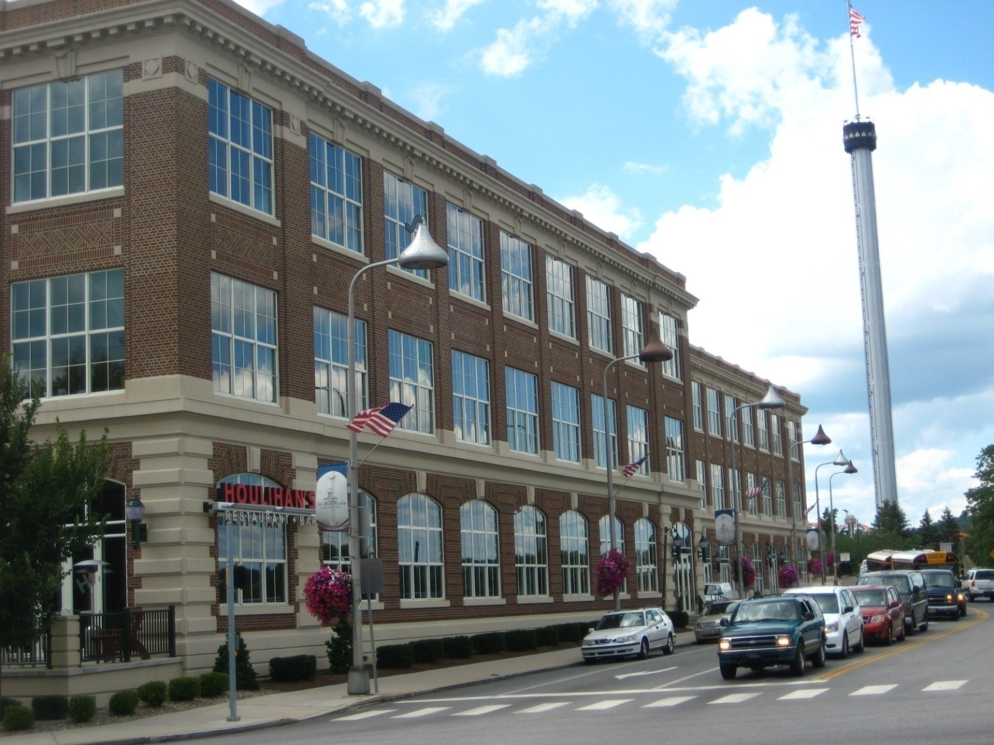
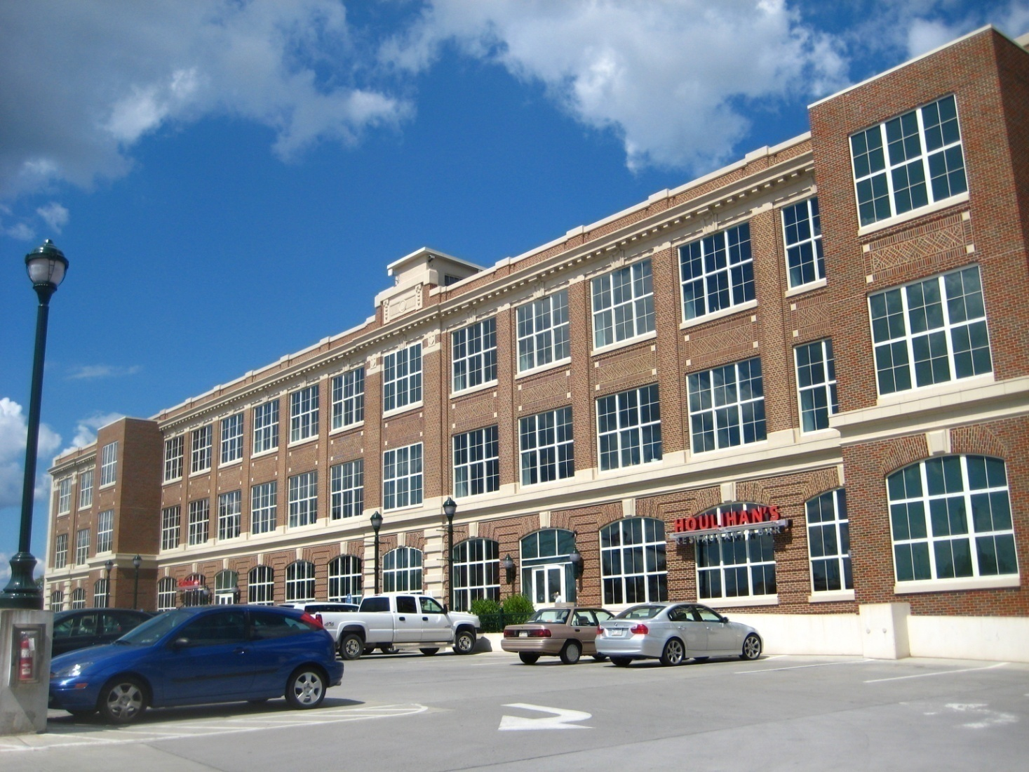
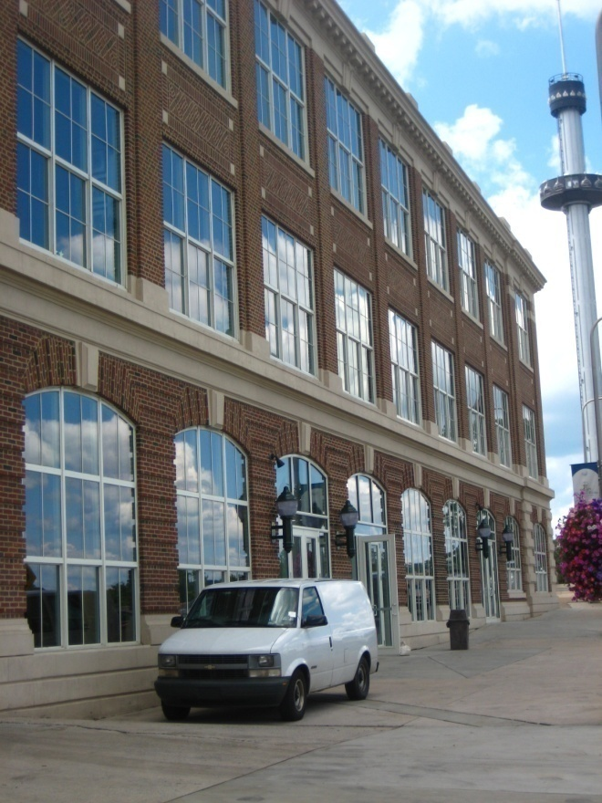
Sustainable Retrofit Options
for the Hershey Press Building
Hershey, PA
Alyssa Adams AE Senior Thesis 2009 Mechanical Option

Slide 2
Presentation Outline
Project and Building Overview
Existing Conditions
Mechanical System Sustainable Retrofit
  Water Efficiency
  Current Make-Up Water for Cooling Tower Design
  Design of Water Collection System
  Design Costs and Payback Analysis
  Energy Efficiency
  Current WSHP Loop and Pump Design
  Energy Comparison to Pumps with VFD
  Design Costs and Payback Analysis
  Indoor Environment Quality
  Explanation of Current DOAS System
  Proposed Re-design for Improved IEQ
  Design Costs and Payback Analysis
Sustainable Results
Conclusions and Recommendations

Slide 3
Presentation Outline
Project and Building Overview
Existing Conditions
Mechanical System Sustainable Retrofit
  Water Efficiency
  Current Make-Up Water for Cooling Tower Design
  Design of Water Collection System
  Design Costs and Payback Analysis
  Energy Efficiency
  Current WSHP Loop and Pump Design
  Energy Comparison to Pumps with VFD
  Design Costs and Payback Analysis
  Indoor Environment Quality
  Explanation of Current DOAS System
  Proposed Re-design for Improved IEQ
  Design Costs and Payback Analysis
Sustainable Results
Conclusions and Recommendations

Slide 4
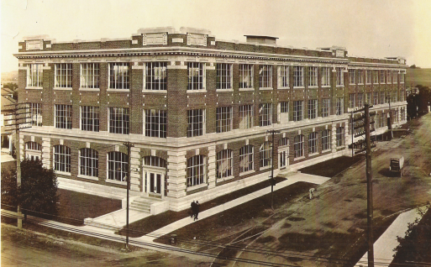
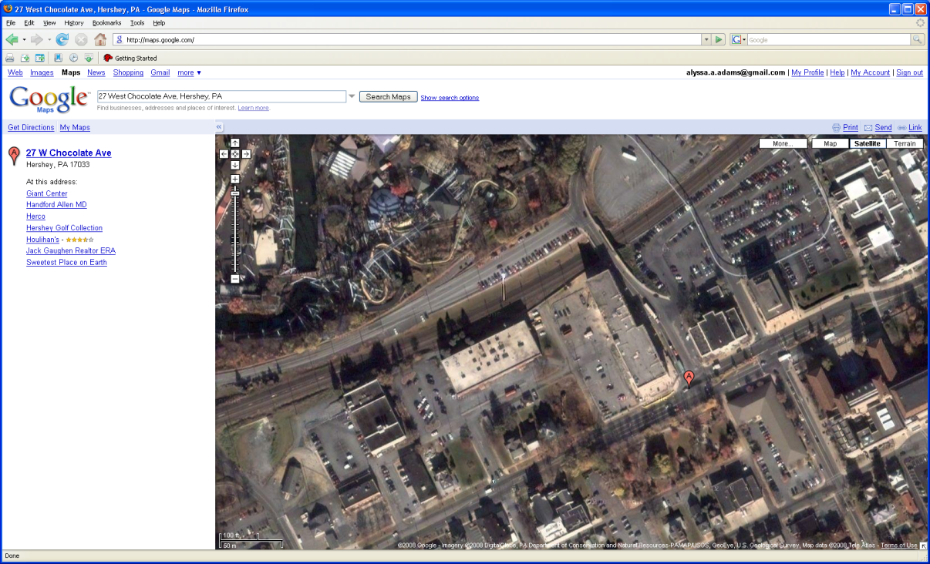
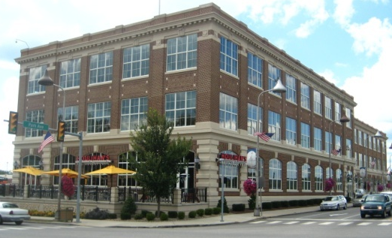
Before
Project Site
After
Park Avenue
Chocolate Avenue
1915
2009

Slide 5

Project Information
Project Site
After
Owner
    Hershey Entertainment & Resorts
Location
Hershey, PA
Project Size
75,000 square feet
Total Cost
$8,000,000 Renovation
Design-Bid-Build Contract
Exception of Mechanical and Electrical Contractors, both Design/Build
Construction Duration
November 2003 to November 2005
Park Avenue
Chocolate Avenue
2009

Slide 6
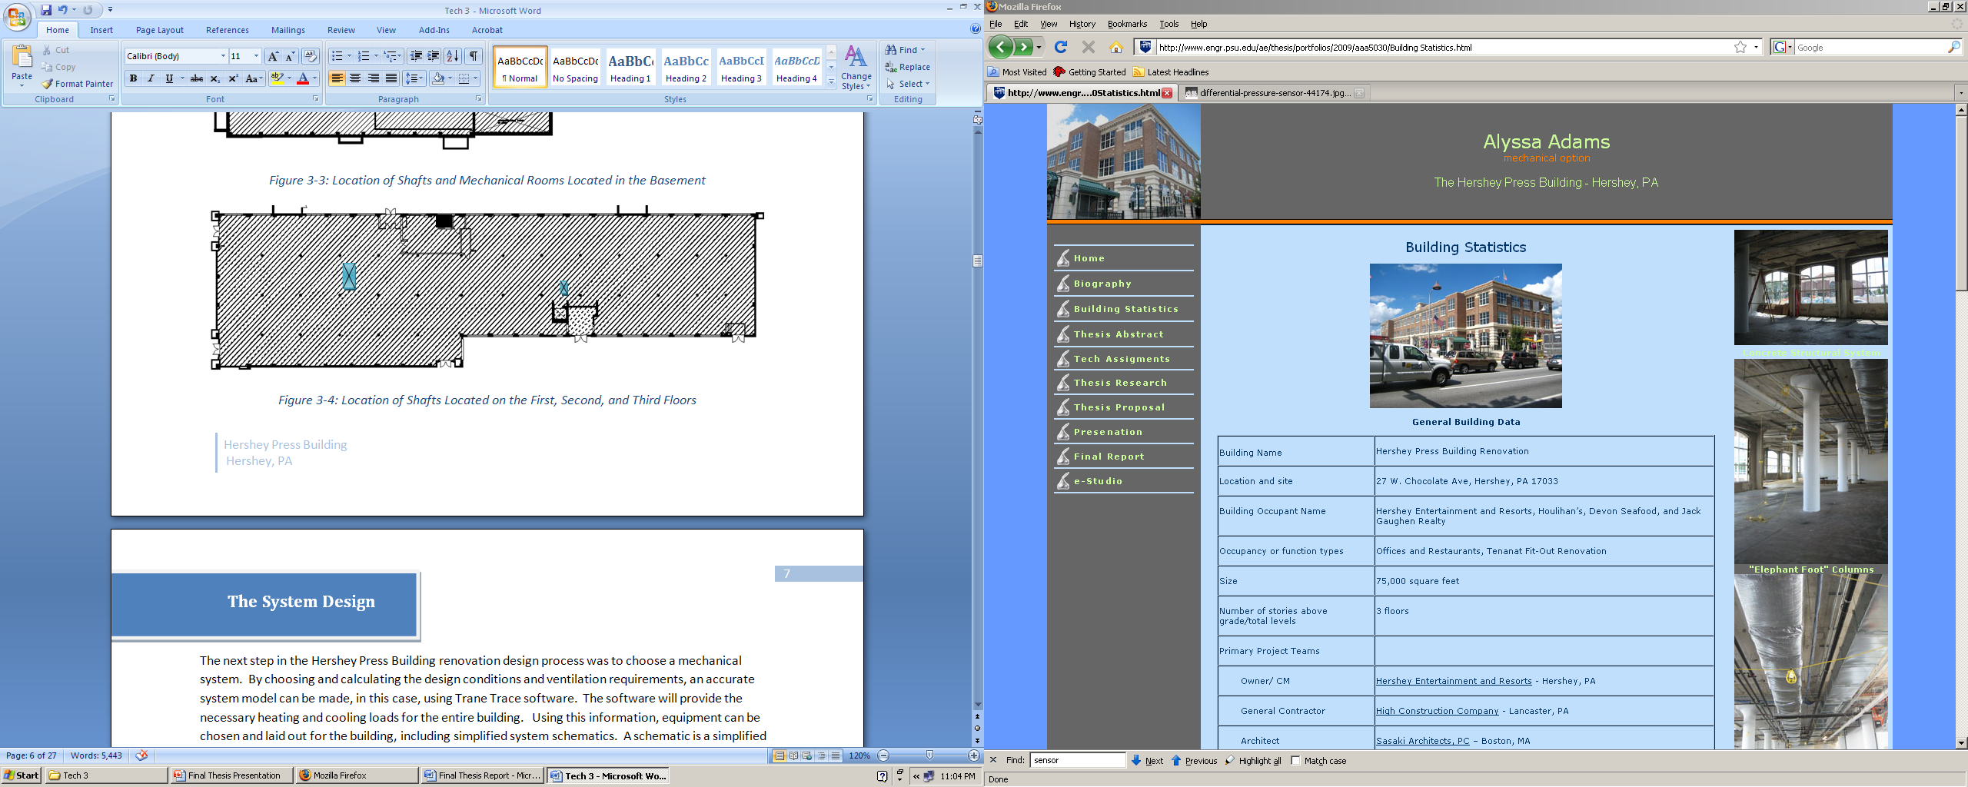
Project Information
Floor Plan
After
Owner
    Hershey Entertainment & Resorts
Location
Hershey, PA
Project Size
75,000 square feet
Total Cost
$8,000,000 Renovation
Design-Bid-Build Contract
Exception of Mechanical and Electrical Contractors, both Design/Build
Construction Duration
November 2003 to November 2005
Jack Gaughen Realty
Devon
Seafood
Houlihan’s
First Floor
2009

Slide 7





Project Information
Floor Plan
Project Team
Owner
    Hershey Entertainment & Resorts
Location
Hershey, PA
Project Size
75,000 square feet
Total Cost
$8,000,000 Renovation
Design-Bid-Build Contract
Exception of Mechanical and Electrical Contractors, both Design/Build
Construction Duration
November 2003 to November 2005
General Contractor
Architect
Mechanical Engineer
Electrical Engineer
Jack Gaughen Realty
Devon
Seafood
Houlihan’s
Structural Engineer
First Floor

Slide 8
Presentation Outline
Project and Building Overview
Existing Conditions
Mechanical System Sustainable Retrofit
  Water Efficiency
  Current Make-Up Water for Cooling Tower Design
  Design of Water Collection System
  Design Costs and Payback Analysis
  Energy Efficiency
  Current WSHP Loop and Pump Design
  Energy Comparison to Pumps with VFD
  Design Costs and Payback Analysis
  Indoor Environment Quality
  Explanation of Current DOAS System
  Proposed Re-design for Improved IEQ
  Design Costs and Payback Analysis
Sustainable Results
Conclusions and Recommendations

Slide 9
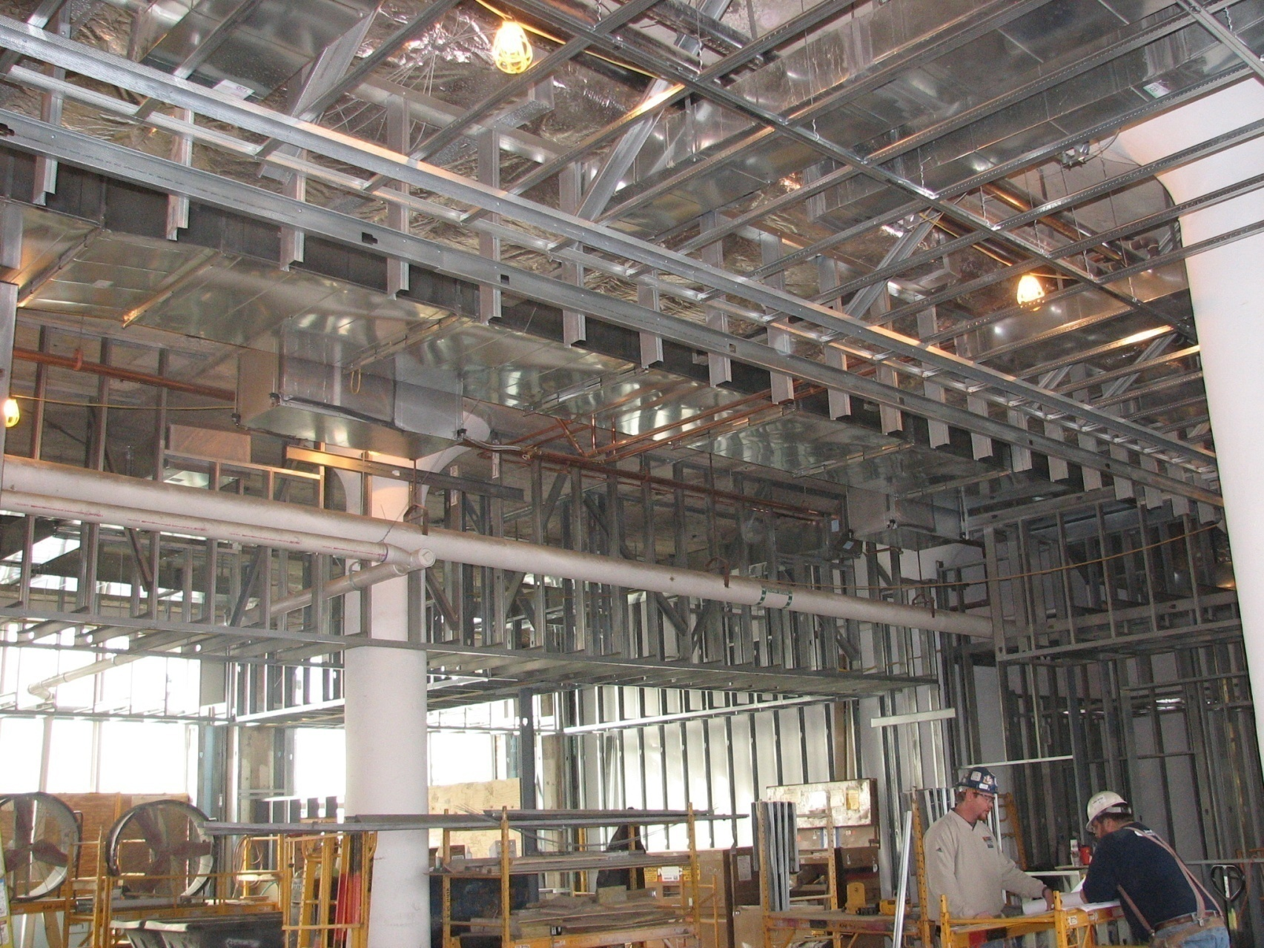
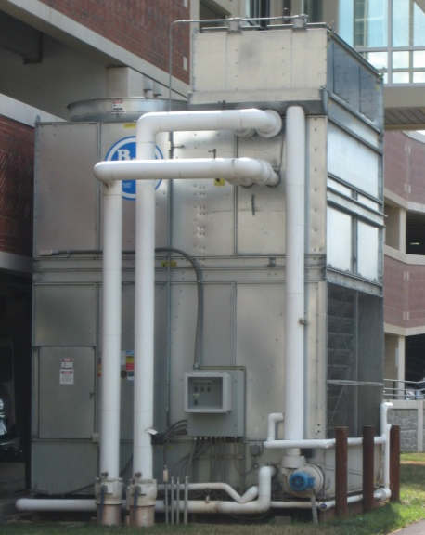
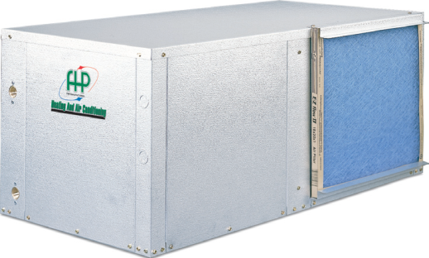
Air Side Mechanical System
Existing Conditions
Water Side Mechanical System
Heat Addition
Boiler – (3) 414 MBH Natural Gas Condensing Boilers
Heat Rejection
Closed Loop Fluid Cooler – 690 GPM
Space Conditioning
(94) 300-6,000 CFM Water-Source Heat Pumps
DOAS Space Ventilation
9,000 & 9,600 CFM Energy Recovery Ventilators
Kitchen Make-Up Air
7,000 & 9,500 CFM Make-Up Air Units

Slide 10
Presentation Outline
Project and Building Overview
Existing Conditions
Mechanical System Sustainable Retrofit
  Water Efficiency
  Current Make-Up Water for Cooling Tower Design
  Design of Water Collection System
  Design Costs and Payback Analysis
  Energy Efficiency
  Current WSHP Loop and Pump Design
  Energy Comparison to Pumps with VFD
  Design Costs and Payback Analysis
  Indoor Environment Quality
  Explanation of Current DOAS System
  Proposed Re-design for Improved IEQ
  Design Costs and Payback Analysis
Sustainable Results
Conclusions and Recommendations

Slide 11
Mechanical System Sustainable Retrofit
  Goal:
            Reduce the Energy Lifecycle Cost for the Building
            Improve in the Indoor Air Quality
            Create a More Sustainable Building Through Retrofit
            Possible Future Owner Implementation
  Focus of Research:
            Water Efficiency
            Energy Efficiency
            Indoor Environment Quality
  Methodology:
            Research
            Cost and Constructability of Redesign
            Payback and Energy Savings
            Recommendation

Slide 12
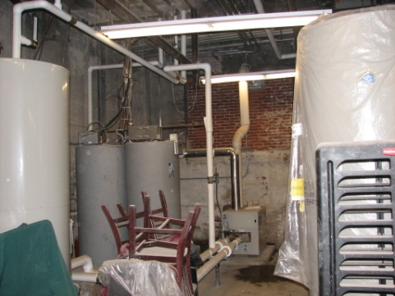
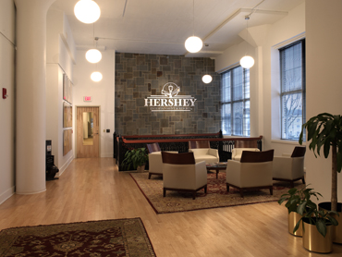
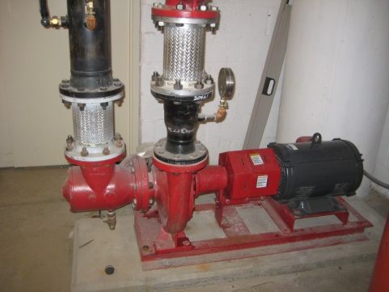
Water Efficiency
Energy Efficiency
Indoor Environment Quality
  Variable Frequency Drives
  + Pumps Respond To Setbacks
  - Life Cycle Cost
  Rainwater Collection for Fluid Cooler
  + Optimal Basement Tie-In Location
  - Cost for Storage Tank Installation
  Direct Duct O/A Re-design for Improved IEQ
  + Ensure Proper Ventilation For Spaces
  - Implementation Cost

Slide 13
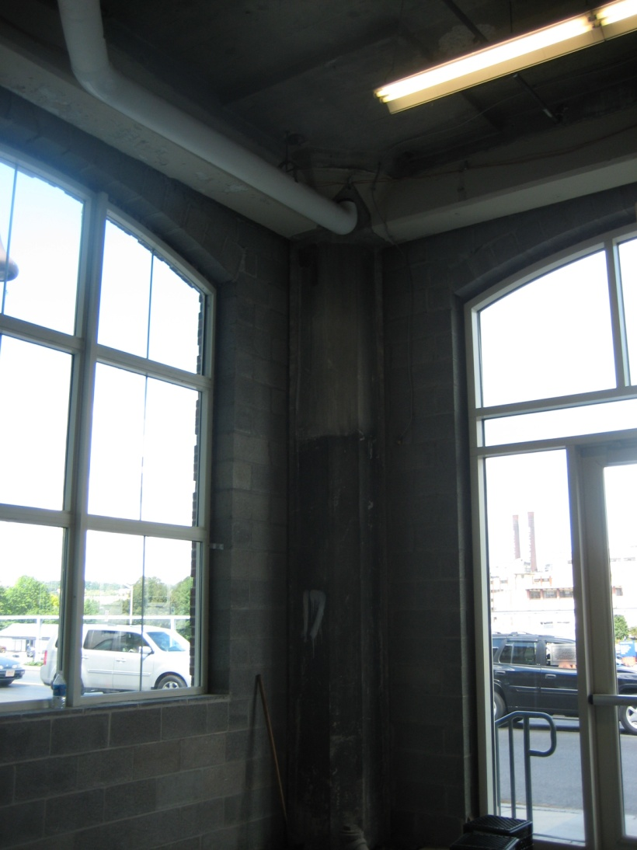
  Rainwater Collection for Fluid Cooler
Water Efficiency
Energy Efficiency
Indoor Environment Quality

Slide 14
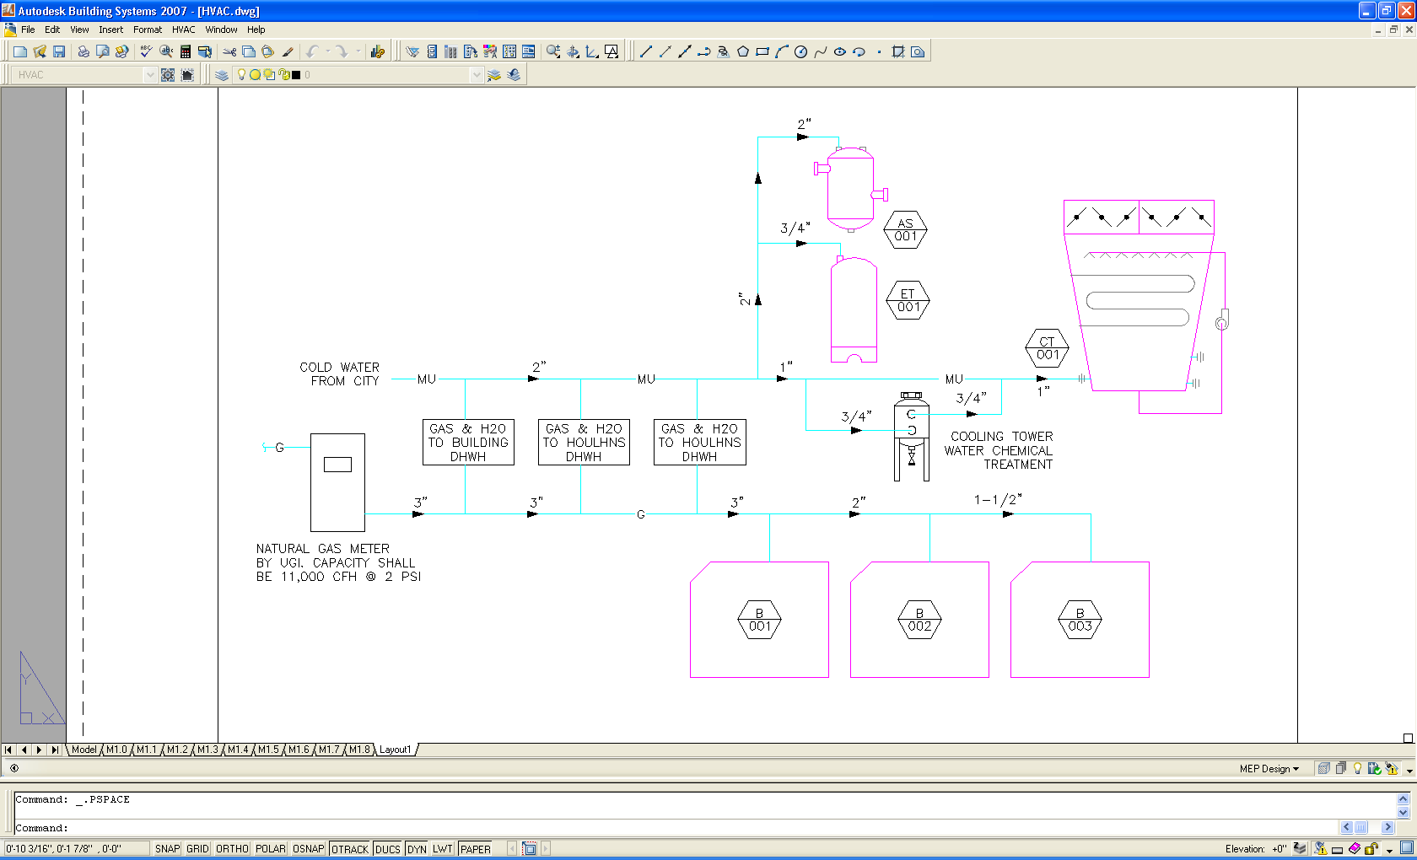
Water Efficiency
Water Efficiency
Energy Efficiency
Indoor Environment Quality
Make-Up Water Schematic

Slide 15
Water Efficiency
Water Efficiency
Energy Efficiency
Indoor Environment Quality
Tank
FC
Site Plan

Slide 16
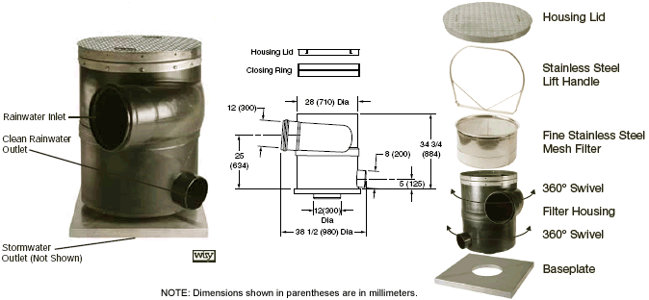
  Water Filtration System
Water Efficiency
Water Efficiency
Energy Efficiency
Indoor Environment Quality
Jay R. Smith 12” Outlet - RH9521-12 Vortex Rainwater Fine Filter

Slide 17
Water Efficiency
Water Efficiency
Energy Efficiency
Indoor Environment Quality
Total Rainwater Collection in Gallons
 | Annual Rainfall (2006-2008) |  | Maximum Available Rain Water to Capture/Month |  | Final Adjusted Gallons of Rainwater
 | 3-Year Average (in) | 3- Year Average (ft) | Avg. Rain (ft) * Area (ft) = (ft3) | Total Volume of Rain (gallons) | Adjusted for 10% Evaporation Loss (gallons)
Apr | 3.37 | 0.28 | 7,778 | 58,218 | 52,396
May | 3.03 | 0.25 | 10,901 | 81,595 | 73,436
Jun | 5.80 | 0.48 | 5,118 | 38,309 | 34,478
Jul | 4.03 | 0.34 | 7,113 | 53,240 | 47,916
Aug | 3.30 | 0.28 | 2,196 | 16,440 | 14,796
Sep | 4.60 | 0.38 | 13,319 | 99,694 | 89,724
Oct | 3.93 | 0.33 | 3,849 | 28,807 | 25,926

Slide 18
Water Efficiency
Water Efficiency
Energy Efficiency
Indoor Environment Quality
Annual Rain Water Data & Fluid Cooler Requirement Comparison
 | Total Gallons of Rain Water | Fluid Cooler Requirement | Additional Water Required | Savings
 | in Gallons/month | in Gallons/month | in Gallons/month | $0.0097 / Gal
Apr | 52,396 | 62,000 | 9,604 | $508.24
May | 73,436 | 109,200 | 35,764 | $712.33
Jun | 34,478 | 127,800 | 93,322 | $334.44
Jul | 47,916 | 137,700 | 89,784 | $464.79
Aug | 14,796 | 132,100 | 117,304 | $143.52
Sep | 89,724 | 100,900 | 11,176 | $870.32
Oct | 25,926 | 63,800 | 37,874 | $251.48
Total | 338,672 | 733,500 | 394,828 | $3,285.12

Slide 19
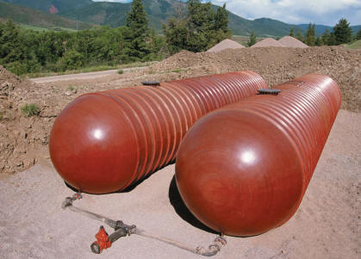
Water Efficiency
Water Efficiency
Energy Efficiency
Indoor Environment Quality
Calculations to Size a Rain Water Storage Tank
Volume (ft³) | = | Pi | *Radius² (ft²) | * Length (ft)
4,278 (32,000 gallons) | = | 3.14 | *(5)² | * 55
Total Cost for Underground Rain Water Collection System
 | Cost
Storage Tank | $90,000.00
Installation | $29,700.00
Total | $157,320.00
Payback for an Underground Rain Water Collection System
First Cost | An Savings | Payback (Years)
$157,320.00 | $3,285.12 | 47.9

Slide 20

  Recommendation
Water Efficiency
Water Efficiency
Energy Efficiency
Indoor Environment Quality
  First Cost of $157,320.00
  Annual Savings of $3,285.00
  48 Year Payback
  Overall Value of Building Increased
  Creates a More Sustainable Building
Not Recommended Without Researching Options of Water Efficiency on Site

Slide 21

  Addition of Variable Frequency Drives
Water Efficiency
Energy Efficiency
Energy Efficiency
Indoor Environment Quality

Slide 22
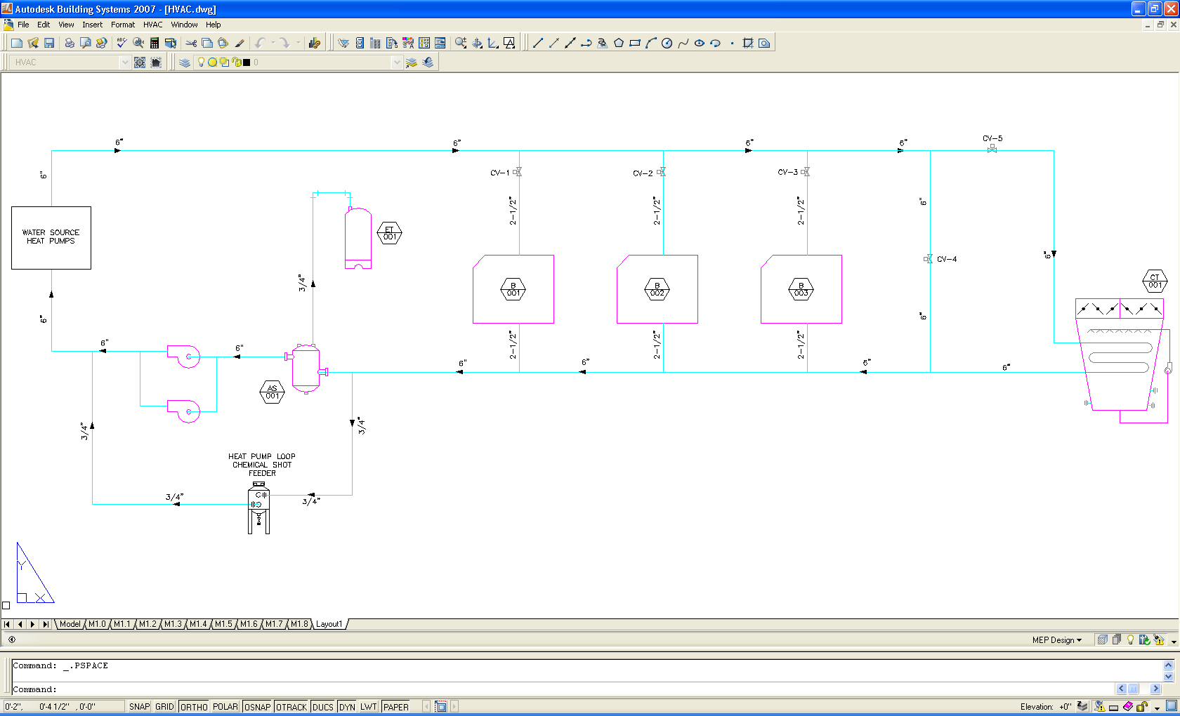
  Current Design
Water Efficiency
Energy Efficiency
Energy Efficiency
Indoor Environment Quality
Water Source Heat Pump Loop Schematic

Slide 23
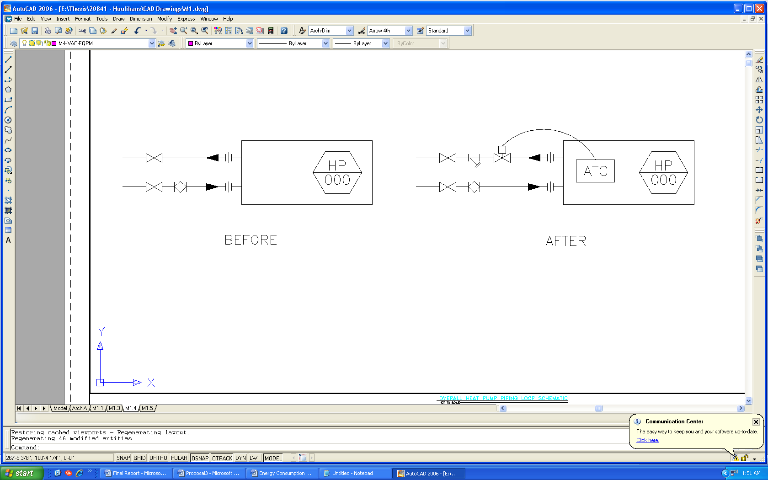
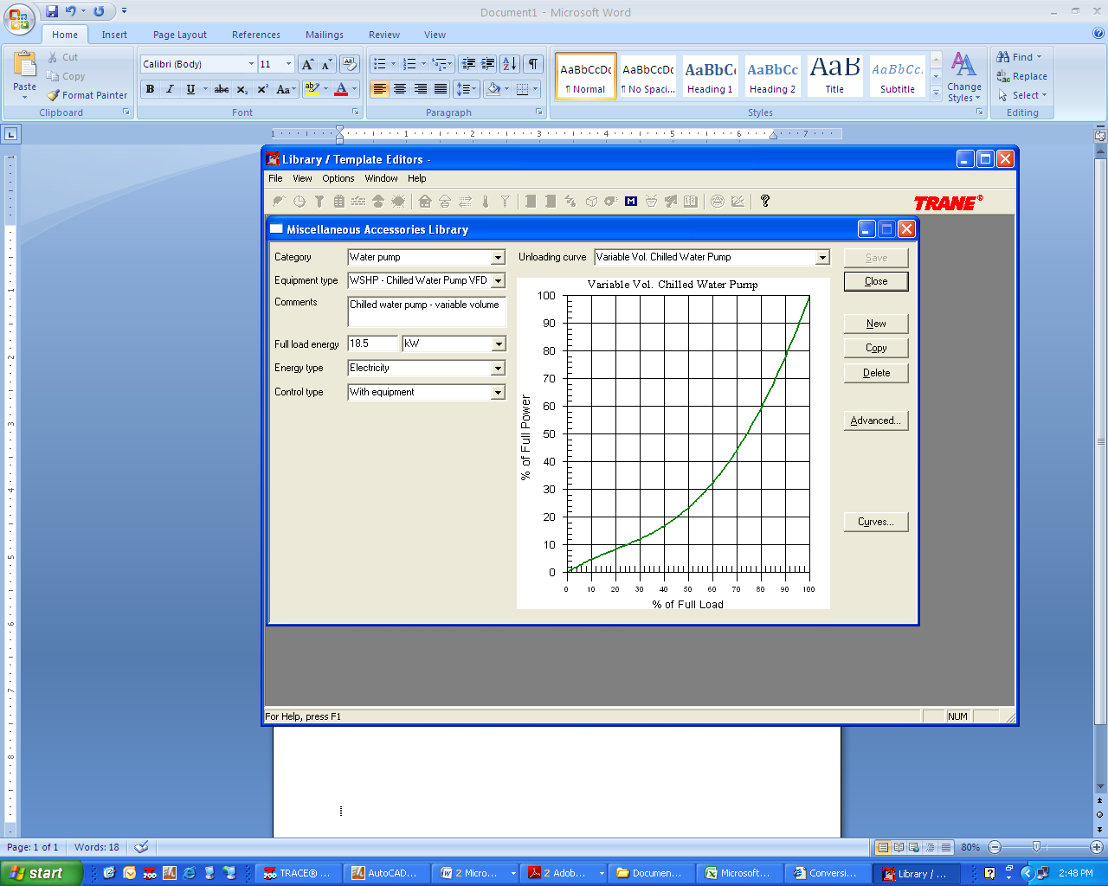
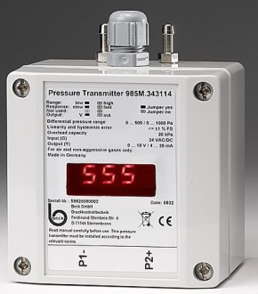
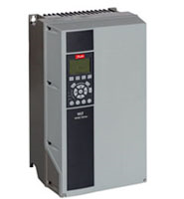
  Pump Redesign
Water Efficiency
Energy Efficiency
Energy Efficiency
Indoor Environment Quality
Change in Heat Pump Control Configurations
Unloading Curve for (2) VFD Additions
Pressure Sensors Located In Piping

Slide 24
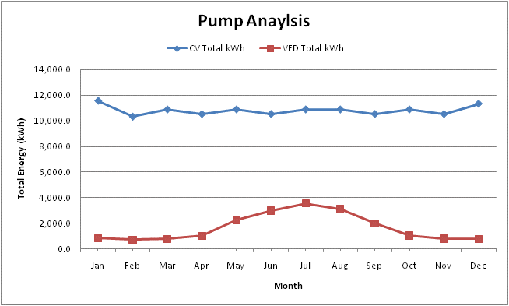
  Energy Comparison
Water Efficiency
Energy Efficiency
Energy Efficiency
Indoor Environment Quality
Based on usage, the average savings is 9,000 kWh/month

Slide 25
  Calculated Savings
Water Efficiency
Energy Efficiency
Energy Efficiency
Indoor Environment Quality
Annual Savings with a VFD
 | Peak kW Savings with VFD | kWh Savings with VFD | Current Cost of Electricity | Proposed Cost of Electricity with VFDs | Total Savings with VFD
Jan | 11.7 | 10,719.1 | $13,729.75 | $12,986.03 | $743.72
Feb | 11.7 | 9,608.5 | $13,072.06 | $12,390.23 | $681.83
Mar | 14.5 | 10,103.9 | $14,657.02 | $13,912.55 | $744.47
Apr | 11.1 | 9,526.2 | $14,800.35 | $14,130.62 | $669.73
May | 5.5 | 8,669.3 | $16,939.37 | $16,387.45 | $551.92
Jun | 3.2 | 7,561.3 | $17,595.50 | $17,134.10 | $461.40
Jul | 0.8 | 7,364.1 | $17,879.51 | $17,459.12 | $420.39
Aug | 1.9 | 7,813.0 | $18,503.86 | $17,610.22 | $893.64
Sep | 6.1 | 8,546.5 | $16,380.33 | $15,841.18 | $539.15
Oct | 10.9 | 9,842.5 | $15,272.47 | $14,599.68 | $672.79
Nov | 13.4 | 9,728.0 | $14,245.93 | $13,545.79 | $700.14
Dec | 12.4 | 10,560.2 | $13,618.00 | $12,886.77 | $731.23
Total | 14.5 | 110,042.6 | $186,694.15 | $178,883.74 | $7,810.41

Slide 26
Water Efficiency
Energy Efficiency
Energy Efficiency
Indoor Environment Quality
Option 1: No VFD - $0
Option 2: First Design/Install - $54,400
Variable Frequency Drive Cost Estimate - First Design/Install
Material | Purchase and Install | Quantity | Total Cost
Heat Pump Controls (per HP) | $ 500.00 | 94 | $ 47,000.00
Pressure Sensors (per Sensor) | $ 500.00 | 2 | $ 1,000.00
Variable Frequency Drives (per VFD) | $ 1,700.00 | 2 | $ 3,400.00
Electric Install | $ 3,000.00 | 1 | $ 3,000.00
 |  | TOTAL | $ 54,400.00
Option 3: Retrofit - $92,000
Variable Frequency Drive Cost Estimate – Retrofit
Material | Purchase and Install | Quantity | Total Cost
Heat Pump Controls (per HP) | $ 900.00 | 94 | $ 84,600.00
Pressure Sensors (per Sensor) | $ 500.00 | 2 | $ 1,000.00
Variable Frequency Drives (per VFD) | $ 1,700.00 | 2 | $ 3,400.00
Electric Install | $ 3,000.00 | 1 | $ 3,000.00
 |  | TOTAL | $ 92,000.00

Slide 27
  Payback and Life Cycle Cost (LCC)
Water Efficiency
Energy Efficiency
Energy Efficiency
Indoor Environment Quality
Payback to Install Two Variable Frequency Drives
Type | First Cost | An Savings | Payback (Years)
First Design/Install | $54,400.00 | $7,810.41 | 8.1
Retrofit | $92,000.00 | $7,810.41 | 13.8
LCC Analysis to Install Two Variable Frequency Drives
Life Cycle Cost Analysis
 | No VFD | VFD - Original Install | VFD - Retrofit
Initial Capital | $10,000 | $64,400 | $102,000
Service Life | 20 | 20 | 20
Annual Op Cost | $6,917 | $1,053 | $1,053
Maintenance/Repair | $100 | $100 | $100
Salvage Value | $0 | $0 | $0
i=6%
LCC Life Cycle Cost | $90,484 | $77,625 | $115,225

Slide 28
  Recommendation
Water Efficiency
Energy Efficiency
Energy Efficiency
Indoor Environment Quality
  Option 1
  First Cost Eliminated
  Second Lowest Life Cycle Cost of $90,484
  Constant Volume Pumping Is Not Energy Efficient
  Option 2
  First Cost of $54,400
  Lowest Life Cycle Cost of $77,625
  8.1 Year Payback
  Best Viable Option in Retrospect
  Option 3
  First Cost of $102,000
  Total Life Cycle Cost of $115,225
  14 Year Payback
  Possible Reduction in Future Energy Costs
Option 3 Recommended Based
Future Reduction of Energy
Usage and Cost

Slide 29
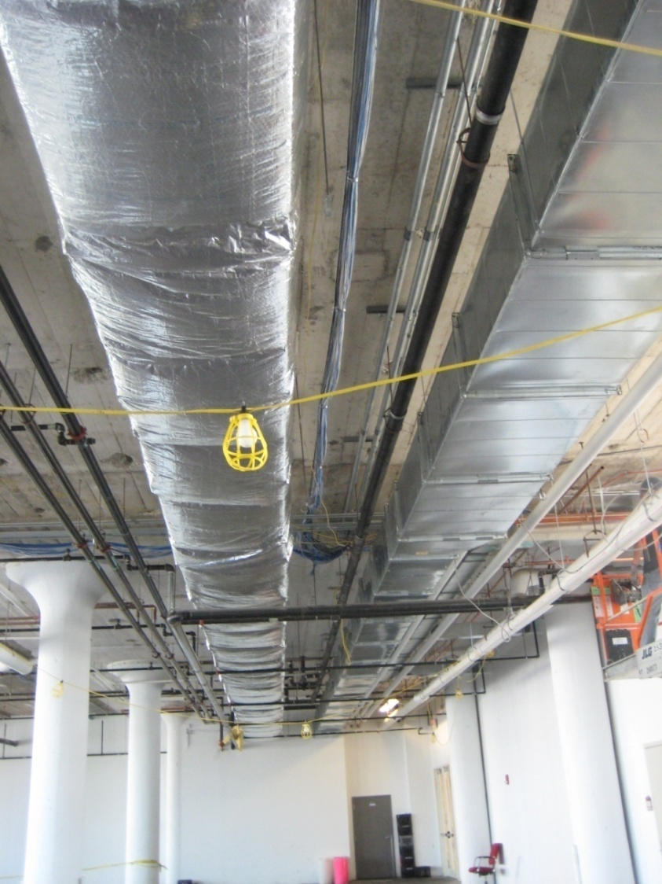
  Direct Duct O/A Redesign
Indoor Environment Quality
Water Efficiency
Energy Efficiency

Slide 30
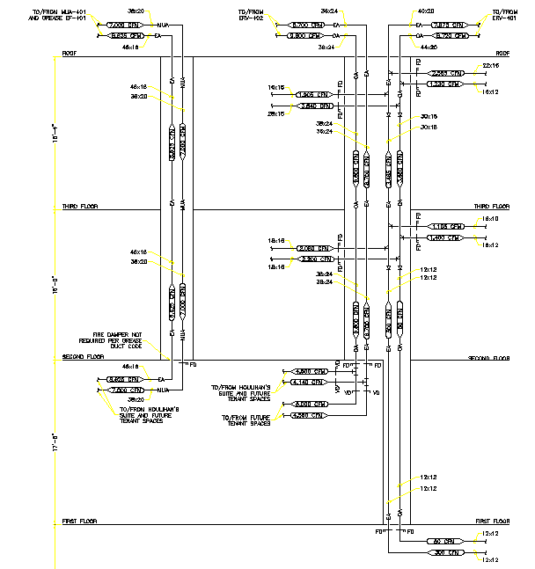
  Current Design
Indoor Environment Quality
Water Efficiency
Energy Efficiency

Slide 31
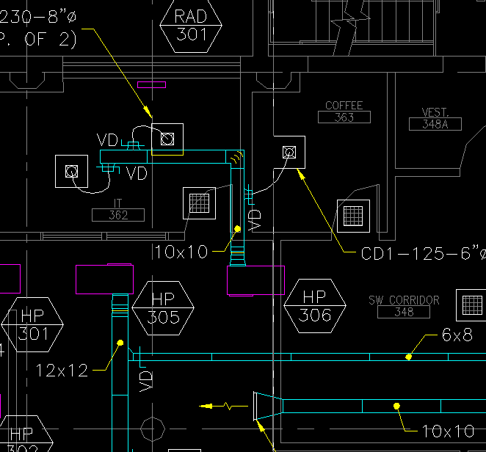
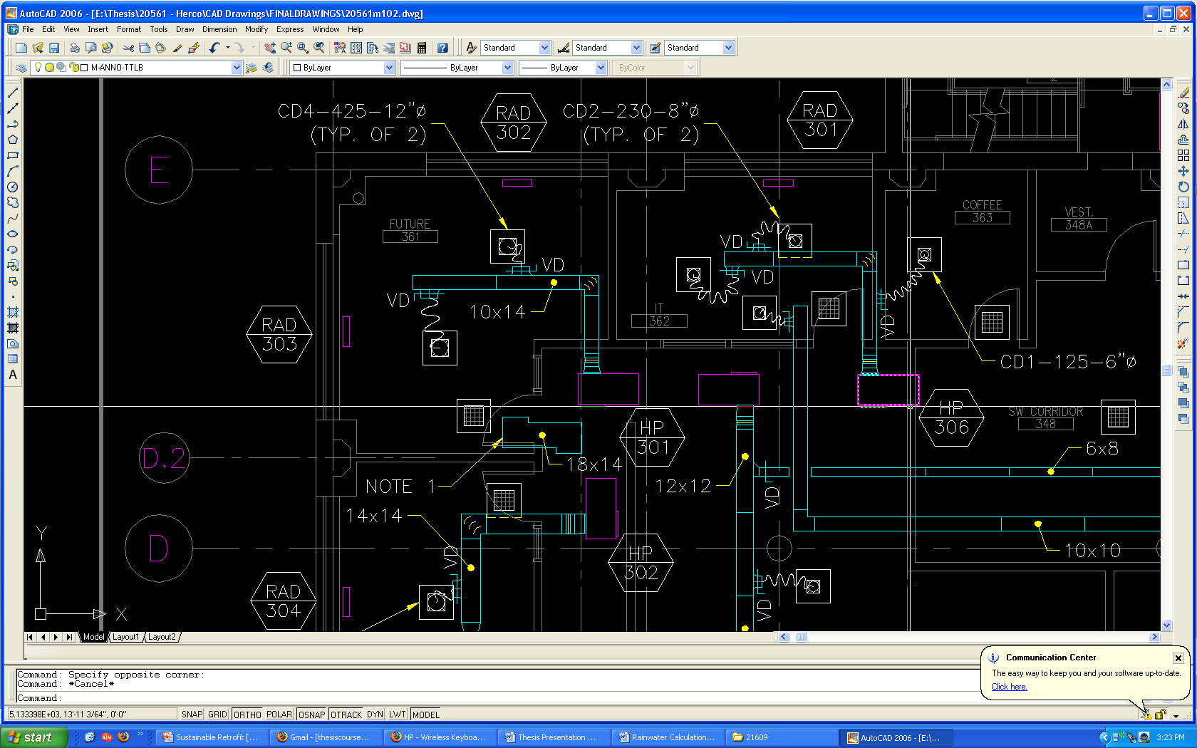
  DOAS Redesign
Indoor Environment Quality
Water Efficiency
Energy Efficiency
Before After
By direct-ducting the O/A, ventilation of each space can be properly ventilated for improved IEQ.

Slide 32
  Cost Estimate
Indoor Environment Quality
Water Efficiency
Energy Efficiency
Direct Cost Estimate of Materials and Labor
Component | Unit | Quantity | Material | Labor | Total/Unit | Total
Diffusers | PIECE | 171 | $100.00 | $75.00 | $175.00 | $29,925.00
Flex Duct | FT | 1051 | $1.50 | $37.50 | $39.00* | $7,989.00
Rectangular Sheet Metal | SF | 5363 | $2.25 | $20.00 | $22.25 | $119,326.75
Round Sheet Metal | SF | 457 | $2.25 | $20.00 | $22.25 | $10,168.25
Insulation, 1-1/2" | SF | 5820 |  |  | $1.65 | $9,603.00
Total |  |  |  |  |  | $177,012.00
*Flex duct will cost $37.50 per 8' maximum of flex to install.
TOTAL ESTIMATE FOR DIRECT DUCT VENTILATION
Description | Cost | % Total Budget
Materials and Labor | $177,012 | 74.8%
Testing, Adjusting, Balancing | $20,000 | 8.4%
Warranty | $898 | 0.4%
General Conditions | $5,937 | 2.5%
Overhead & Mark-up | $16,308 | 6.9%
Profit | $6,605 | 2.8%
Contingency | $10,000 | 4.2%
Recommended Cost | $236,759 | 100.0%

Slide 33
  Schedule Development
Indoor Environment Quality
Water Efficiency
Energy Efficiency
Crew and Duration Schedule
 | Sheet Metal |  |  | Flex and Diffusers
 | Sheet Metal (linear feet) | Sheet Metal Crew (people) | Sheet Metal (days) | Flex (Pieces) | Flex Crew (people) | Diffusers (pieces) | Diffuser Crew (people) | Flex/Diffuser (days)
Houlihan’s | 192 | 8 | 2 | 19 | 1 | 19 | 1 | 2
Jack Gaughen | 205 | 8 | 2 | 22 | 1 | 22 | 1 | 3
Devon Seafood | 240 | 8 | 3 | 11 | 1 | 11 | 1 | 1
HE&R - 2nd Floor | 797 | 8 | 9 | 61 | 1 | 61 | 1 | 8
HE&R - 3rd Floor | 695 | 8 | 8 | 58 | 1 | 58 | 1 | 7
Hours of Occupancy and Construction
 | Hours of Occupancy | Hours of Construction
Houlihan’s | 11am-11pm | 2am-10am
Jack Gaughen | 7am-6pm | 6pm-2am
Devon Seafood | 11am-12pm | 2am-10am
HE&R - 2nd Floor | 7am-6pm | 6pm-2am
HE&R - 3rd Floor | 7am-6pm | 6pm-2am

Slide 34
  Final Schedule
Indoor Environment Quality
Water Efficiency
Energy Efficiency

Slide 35

  Recommendation
Indoor Environment Quality
Water Efficiency
Energy Efficiency
  First Cost of $236,759.00
  26-Day Construction Schedule for Implementation
  Construction to Occur While Building is Occupied
  Possible Correlation between Increased Ventilation and Increased Productivity
  Air Monitoring in Spaces Shall Take Place Prior to Recommendation

Slide 36
Presentation Outline
Project and Building Overview
Existing Conditions
Mechanical System Sustainable Retrofit
  Water Efficiency
  Current Make-Up Water for Cooling Tower Design
  Design of Water Collection System
  Design Costs and Payback Analysis
  Energy Efficiency
  Current WSHP Loop and Pump Design
  Energy Comparison to Pumps with VFD
  Design Costs and Payback Analysis
  Indoor Environment Quality
  Explanation of Current DOAS System
  Proposed Re-design for Improved IEQ
  Design Costs and Payback Analysis
Sustainable Results
Conclusions and Recommendations

Slide 37
LEED Sustainable Results
Hershey Press Building LEED Analysis Certification Checklist Summary
 | Sustainable Sites | Water Efficiency | Energy and Atmosphere | Materials and Resources | Indoor Environment Quality | LEED Innovation Credits | Total
Yes | 0 | 1 | 8 | 0 | 5 | 0 | 14
Maybe | 14 | 0 | 0 | 10 | 5 | 5 | 34
No | 0 | 4 | 5 | 3 | 5 | 0 | 17
Total | 14 | 5 | 13 | 13 | 15 | 5 | 65
  Water Efficiency
  +1 Innovative Wastewater Technologies
  Energy Efficiency
  +6 Optimize Energy Performance
  Indoor Environment Quality
  +1 Outdoor Air Delivery Monitoring
With 14 definite points and 34 possible, Hershey Press Building needs only 24% of the “maybes” fulfilled for a “Certified” Certification

Slide 38
Presentation Outline
Project and Building Overview
Existing Conditions
Mechanical System Sustainable Retrofit
  Water Efficiency
  Current Make-Up Water for Cooling Tower Design
  Design of Water Collection System
  Design Costs and Payback Analysis
  Energy Efficiency
  Current WSHP Loop and Pump Design
  Energy Comparison to Pumps with VFD
  Design Costs and Payback Analysis
  Indoor Environment Quality
  Explanation of Current DOAS System
  Proposed Re-design for Improved IEQ
  Design Costs and Payback Analysis
Sustainable Results
Conclusions and Recommendations

Slide 39
Recommendations
Recommendations
Recommendations
  Water Efficiency
  First Cost of $157,320.00 and an Annual Savings Of $3,285.00
  48 Year Payback
  +1 Innovative Wastewater Technologies
  Not Recommended
  Energy Efficiency
  First Cost at $102,000 with a Total Life Cycle Cost of $115,225
  14 Year Payback
  +6 Optimize Energy Performance
  Reduction in Future Energy Costs
  Recommended
  Indoor Environment Quality
  First Cost of $236,759.00
  26-Day Construction Schedule for Implementation
  +1 Outdoor Air Delivery Monitoring
  Air Monitoring in Spaces Shall Take Place Prior to Recommendation

Slide 40
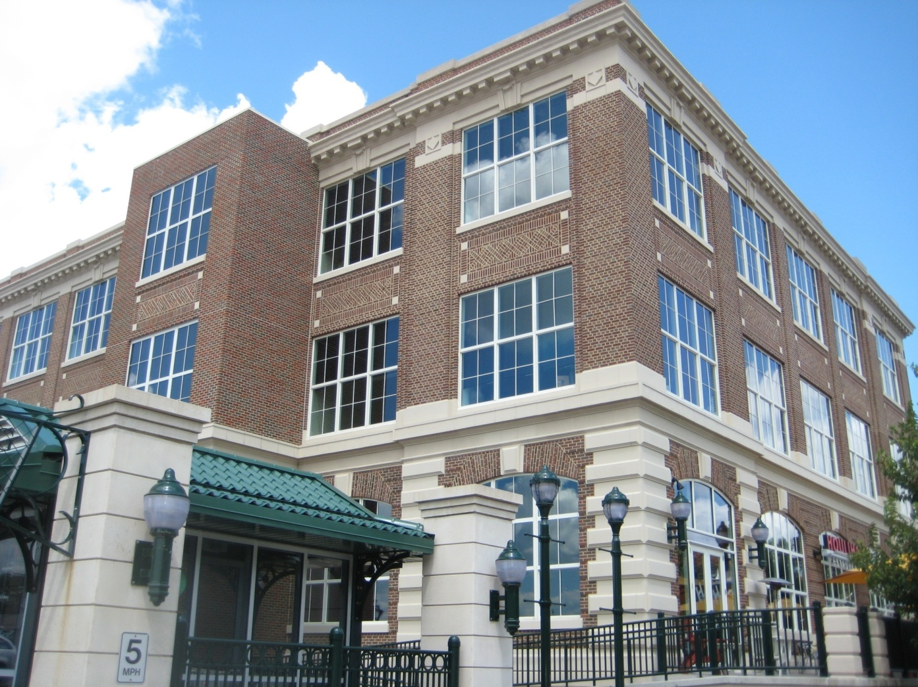
Acknowledgements
Penn State Architectural Engineering Faculty
Thesis Advisor
William Bahnfleth, Ph.D., P.E., Professor
Project Contributors
McClure Company
Greg Koussis of Hershey Entertainment & Results, Project Manager
Dave Lavery of Hershey Entertainment & Resorts, Project Sponsor
Jayne Crabb of M.I. Windows and Doors, Inside Sales Manager
Heath Lewis of M.I. Windows and Doors, Design Engineer
Dan Miller of McClure Company, Estimator
Matt Twomey of High Construction, Consultant
Matt Tressler of McClure Company, Mechanical Engineer
Family and Friends
Questions?

